Slide 1
caArray User Community Meeting
1.x Update and 2.0 Development Status
Call in: 877-416-5524
Participant Passcode: 2627056
Centra: http://ncicb.centra.com
Meeting ID: array_sep12
September 12, 2007

Slide 2
Agenda
Recent Releases
  1.5.0.2
  Grid service on Production
Upcoming Releases
  1.6
  1.7
2.0 Update
  Where we are
  What are the expected results
  What we need from the user community

Slide 3
caArray 1.5.0.2 – Cumulative Patch Release
Released September 10
Upgrades 1.5 with both patches (0.1, 0.2) with GUI installer
1.5.0.1
  Fixed a poor performing public Array search
1.5.0.2
  Fixes association between DerivedBioAssay, MeasuredBioAssayData, DerivedBioAssayData, and Experiment
    Affects users of the MAGE-OM API

Slide 4
Grid service
The 1.5.0.1 grid service was released to Production on August 29
Contains client-side fixes based on feedback from the caB2B team
caB2B team identified some additional items <enter GForge numbers> that we are testing against 1.5.0.2

Slide 5
caArray 1.6 – Maintenance Release
To be released at the end of September (current in QA)
Items addressed include:
  A number of issues that have been identified when loading MAGE-ML files that have been created from MAGE-TAB files using the EBI’s Tab2MAGE converter
  Evaluate removal of partitioning in the database
  Annotation error for existing file in an Experiment
  Performance of adding and updating Sources
  Messaging to user for status of array design parsing
  Sample extract characteristics searches

Slide 6
caArray 1.7 – Maintenance Release
To be released in early November (or sooner)
Focus of this release is to improve data loading performance
We will resume our internal data loading with this release

Slide 7
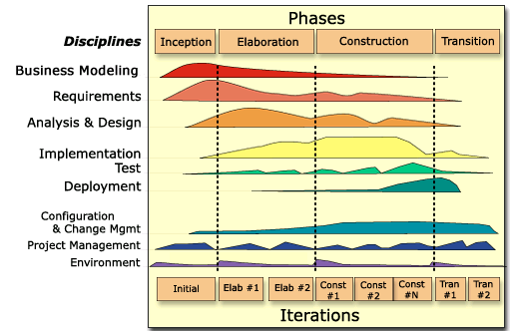
caArray 2.0 - Where We Are
2.0 Elaboration Iteration 2
  Completed 9/6
  Minimal-UI
  Domain Object Model Reviewed, Mentors Added
  MAGE-TAB, Affy .cel and .chp able to be loaded, validated, imported and extracted through Java API
2.0 Construction Iteration 1
  Non-Affy and SNP parsers to be added
  Grid to be completed
  Additional UI Integration
  Search to be started

Slide 8
Results of Elaboration Iteration 2
Project Management:
  Refined 2.0 Schedule, Detailed C1 Schedule and identified release points for 2.0 (Dec 14 targeted for GA deployment)
Requirements:
  Updated Data Management Use Cases and Wrote Permission and Search Related Use Cases
  Initiated Overall UI Design, Use Case Wireframes, and Initial HTML templates
Analysis and Design
  Revised Domain Model based on Community feedback; brought in model elements from caTissue and caBIO
  Completed Design of File Access, Parsers, Data and Design Services
Implementation
  Completed Proof for Data Management (Upload, Validate, Import, Access via API, Login)
Environment
  Completed Proof of Automated Deployment from Dev to QA environments

Slide 9
Goals of Construction Iteration 1
Project Management
  Finalize 2.0 Schedule, Detail C2, C3, T1 Schedule
Requirements
  Continue to gather and incorporate feedback on Use Cases from community members
  Write additional UC’s for User Management (Collaborators, Institutions) and begin 2.x Use Case Writing
  Create and Review wireframes for targeted UCs; overall user interface design
Analysis and Design
  Continue reviewing domain model with community and finalize (Titled “Logical” in caArray_caCORE.eap – available also as html)
  Targeted UC A&D – User Management, Search and Navigation
Implementation
  Complete Grid Service
  Security – Object Level (using CSM 3.2)
  Begin User Management Development
Test
  Build Test Data from Community
  Automate Tests as we build

Slide 10
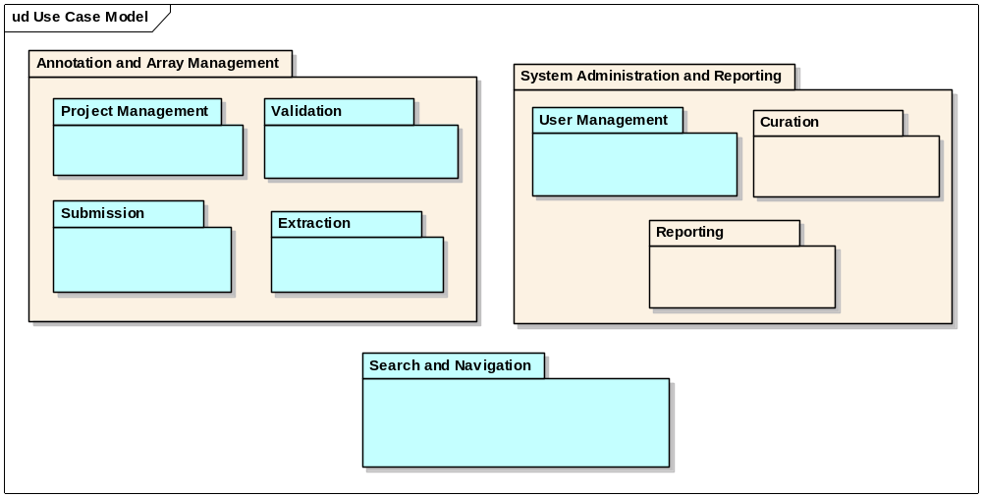
2.0 Use Case Model

Slide 11

C1 Use Case Model and Activities

Slide 12
Decisions from Last Session
Terms to use for logical organization of work/data
  Experiment will represent a single thread of work
  Project will represent a set of work
Should we restrict the ability to change a “Project’s” permissions once a manuscript is published against the data included to only allow for new data to be controlled? Yes
Should only a PI be able to make a “Project” public? Yes
Should we add a project type called “reference” to allow for the availability of a set of say “normal” data to be reused from Project to Project? Yes
Would you allow external institutions to use that data for their own projects (if you both were on the Grid or you allowed collaborators access through the management of permissions?) Yes – if I control what is available

Slide 13
What we need from you and when
Thank you for your establishing the initial priority and the review of the targeted use cases
Next round of feedback
  Wire Frames and UI Concepts for:
    Overall Look and Feel
    Use Case Centric Depictions
      Home Page
      Upload, Validate, Import
      Navigate (e.g., “Browse) and Search
      Download
      Experiment Annotation
In October

Slide 14
Continuing Engagement Model
“Happy Hour” Planned for the ICR Face to Face Meeting to review Wireframes in Person
Meeting to be scheduled the week of September 24 to continue review of the domain model
Continue Monthly Meetings
G-Forge site for 2.0 is available that indicates needs, features, use cases and test cases
  We will continue to publish regularly and investigate forums and surveys for targeted feedback
G-forge site: https://gforge.nci.nih.gov/projects/caarray2/

Slide 15
Next Steps
Please visit G-Forge: https://gforge.nci.nih.gov/projects/caarray2/ to view the prioritization of features and use cases (Tracker items)
Results of Construction Iteration 1 October 5th, 2007
Next meeting date: TBA but anticipated October 17, 2007

